Slide 1
What we do today
Part 1
What is intelligence ?
The relation between knowledge and learning & why both are needed for AI
Part 2
Logic for representing knowledge
Logic for reasoning with knowledge

Slide 2
Who am I?
Frank van Harmelen
http://www.cs.vu.nl/~frank.van.harmelen
Studied Maths & CS in Amsterdam
PhD in AI from Edinburgh
Member of Netherlands Royal Academy & European Academy
Prof at VU, leading a group of ±25 researchers
Guest prof. at WUST
Knowledge representation, Semantic Web, Knowledge Graphs, Medical applications

Slide 3
“Definition of intelligence”
carry out complex reasoning (solve physics problems, prove theorems)
draw plausible inferences (diagnose cars, solve a murder mystery)
use natural language (read stories and answer questions about them, carry out extended conversation)
solving novel complex problems (generating plans, designing artifacts)
social activities that require a theory of mind
I do not mean: recognize familiar objects, execute motor skills, or navigate around space; abilities we share with dogs and cats and fish

Slide 4
But isn’t modern AI all about Machine Learning ?
Two main lines of development in AI
symbolic representations
statistical representation
There have been alternativing cycles of one dominating over the other in different decades of the history of AI.

Slide 5
Statistical vs. symbolic AI: very different types of applications
Statistical, Machine Learning, neural networks:
pattern recognition (images, sound, shapes)
motor skills (robots)
speech generation (sound)
search engines
Symbolic, Knowledge Representation, logic:
planning (autonomous space missions)
reasoning (diagnosis, design, decision support)
language generation (conversations)
search engines
This course

Slide 6

Who was the previous president of the United States?
KR
Who was the previous previous president of the United States?
Thinking slow
Thinking fast
ML

Slide 7
Human intelligence = thinking fast & thinking slow
ML
KR
KR
KR
KR
KR

Slide 8
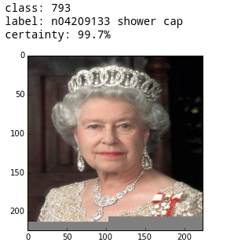
Thinking fast without thinking slow
Class: 793
Label: n04209133 (shower cap)
Certainty: 99.7%

Slide 9
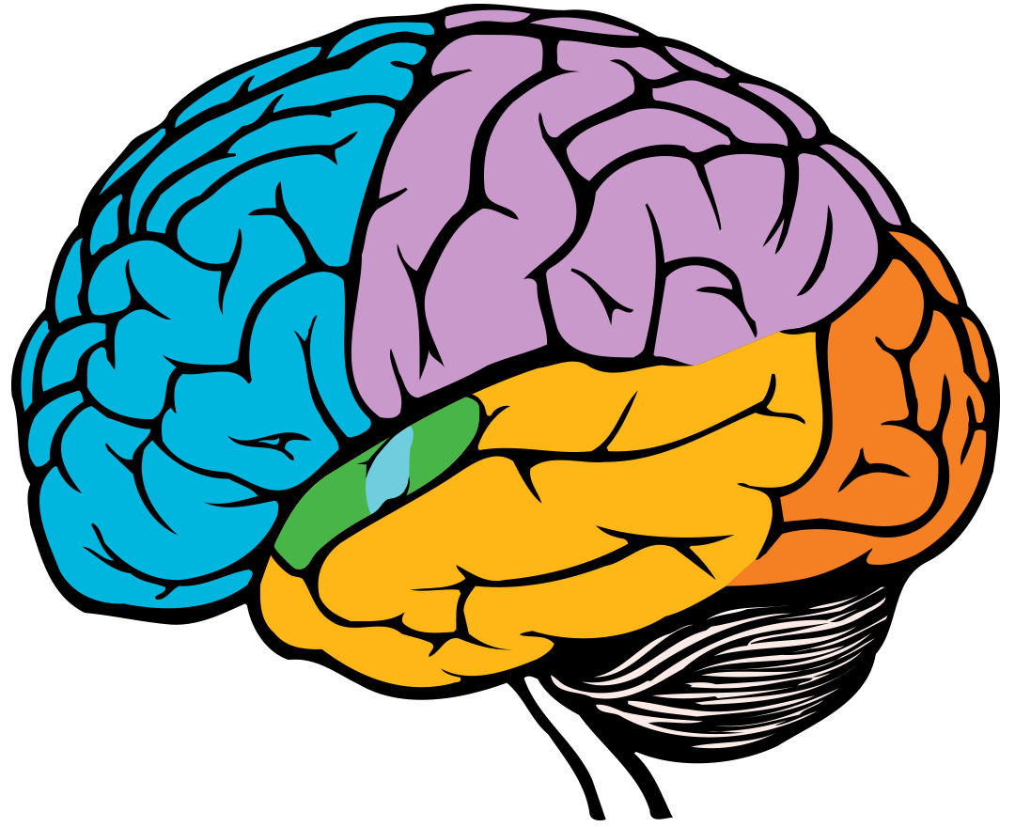
REASONING
PLANNING
PROBLEM SOLVING
MOVEMENT
ORIENTATION
RECOGNITION
PERCEPTION
VISUAL
PROCESSING
AUDITORY
STIMULI
MEMORY
SPEECH

Slide 10
AI that combines all the parts of our brain
Learning (Fast) | Reasoning (Slow)
Better with more data | Worse with more data
Needs lots of data | Already works with very little data
Not explainable | Explainable
Robust against noise | Brittle with noise

Slide 11

What is Automated Reasoning?
Reasoning is the ability to make inferences, and AR is concerned with the building of computing systems that automate this process. (Stanford Encyclopedia of Philosophy)
Traditionally seen as “Automated Theorem Proving”, but now much broader than this:
Handbook of Automated Reasoning (2008): 1000 pages (25 chapters), this course does:
Parts of chapter 1 (logic)
Parts of chapter 2 (SAT solvers)
Parts of chapter 4 (Constraint Solvers)
Parts of chapter 3 (Description Logics)
But also: knowledge graphs, non-monotonic logics, believe revision, probabilities, temporal reasoning, spatial reasoning, reasoning about knowledge & belief, about events about actions, about cause & effect, etc, etc,

